Slide 1
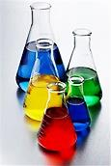
Science—6th Grade
Final Exam Review

Slide 2
Study the following slides. They identify course materials that were covered this year in science and may appear on the final exam.
For example, if you see a slide showing open and closed electric circuits, you should study the slide and also refer to your class materials and notes about that subject and study them.

Slide 3
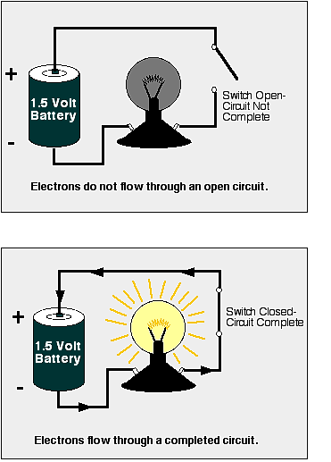
Open and Closed Circuits

Slide 4
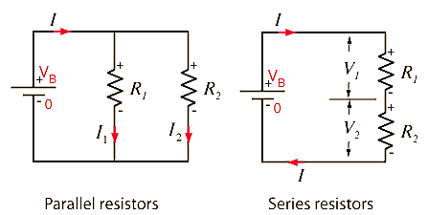

Slide 5
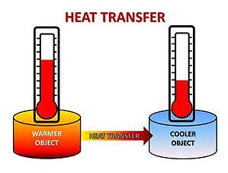
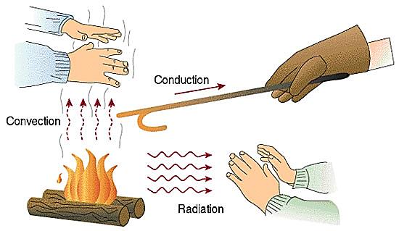
Heat Transfer

Slide 6
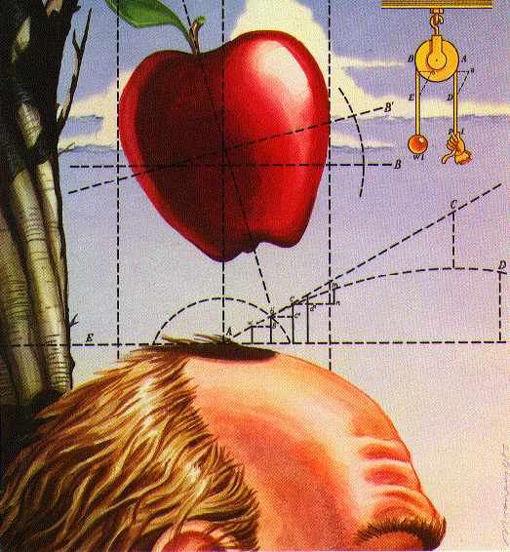
GRAVITY

Slide 7
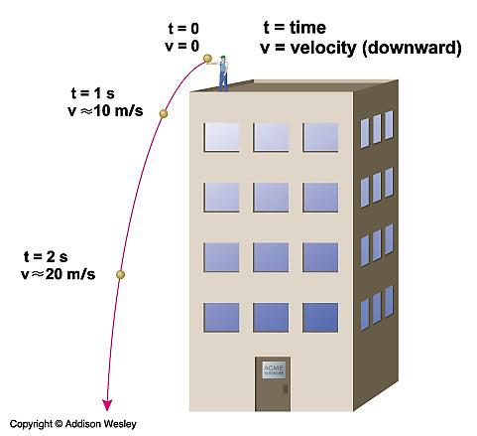
“Speed” means how fast something is going.
“Acceleration” means speed is changing.
A ball thrown off a building starts out at a certain speed, but then accelerates to greater speed as it falls.

Slide 8
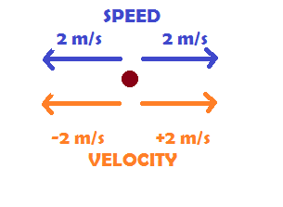

Slide 9
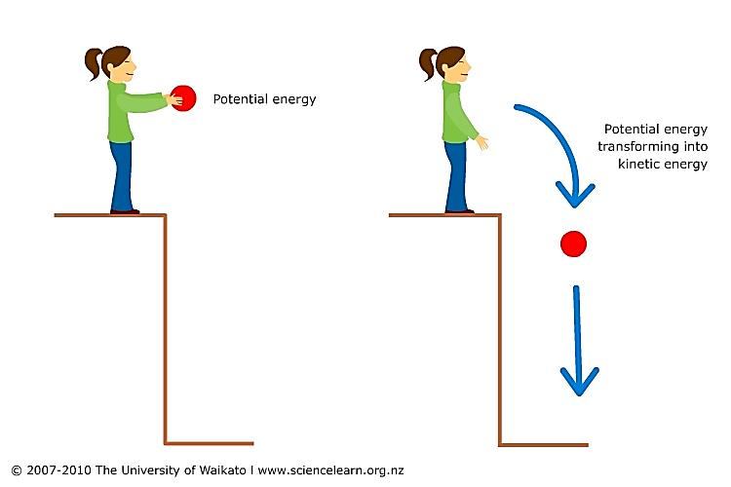
POTENTIAL AND KINETIC ENERGY

Slide 10
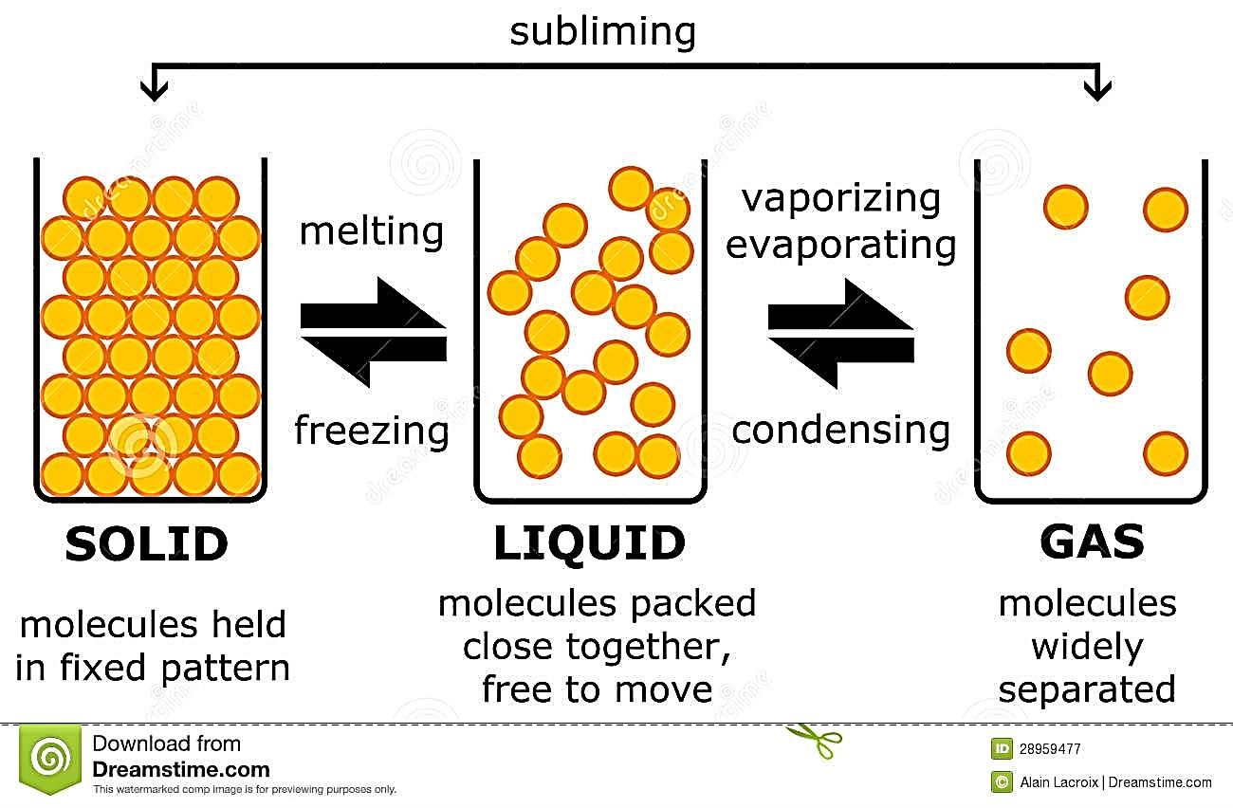

Slide 11
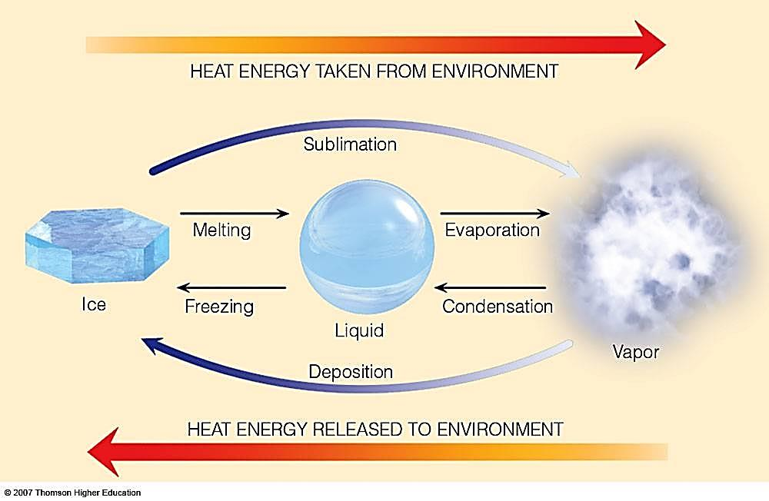

Slide 12
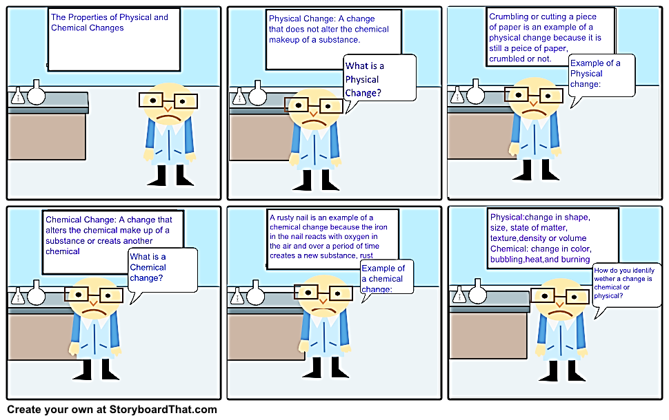
PHYSICAL AND CHEMICAL CHANGES

Slide 13
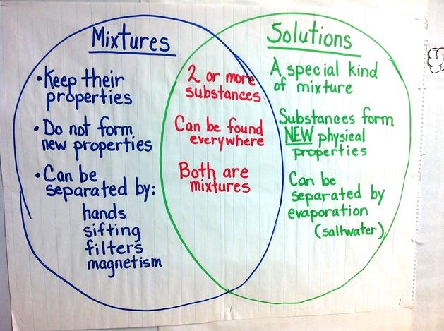

Slide 14
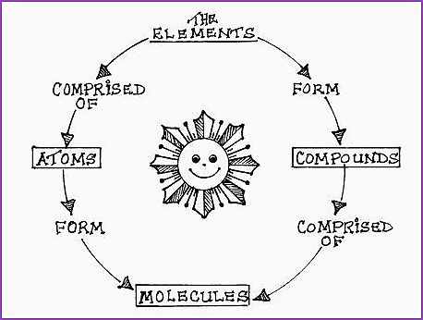
Atoms, Elements, and Compounds

Slide 15
Atom—consists of protons, neutrons, and electrons.
Element—material made up of only one kind of atom; e.g.—carbon, sulfur, helium, etc.
Compound—material made up of two or more elements; e.g.—water, salt, steel, etc.

Slide 16
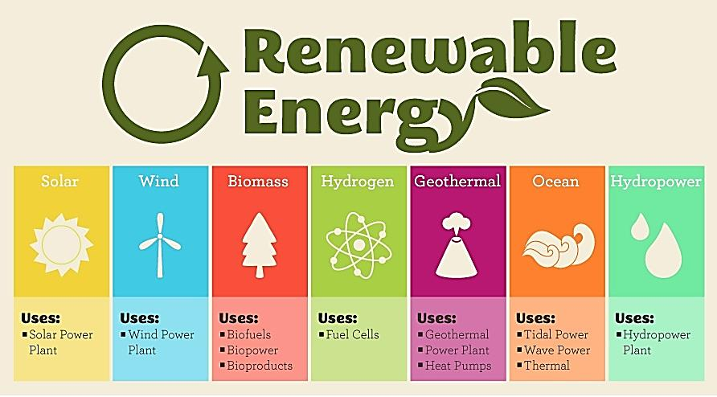

Slide 17
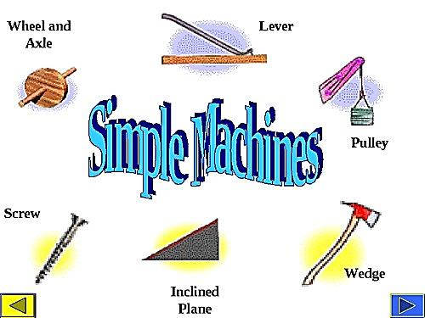

Slide 18
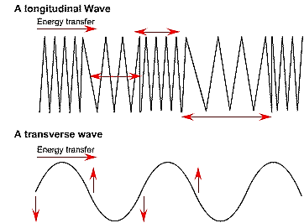

Slide 19
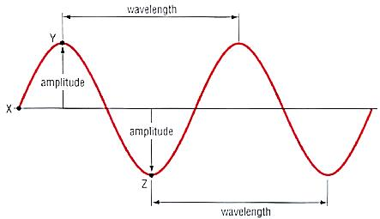

Slide 21
Transparent—light can pass through
Translucent—light can partially pass through
Opaque—light cannot pass through
Luminous—capable of giving off light

Slide 23
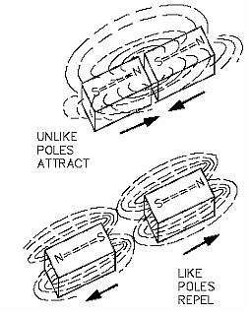

Slide 25
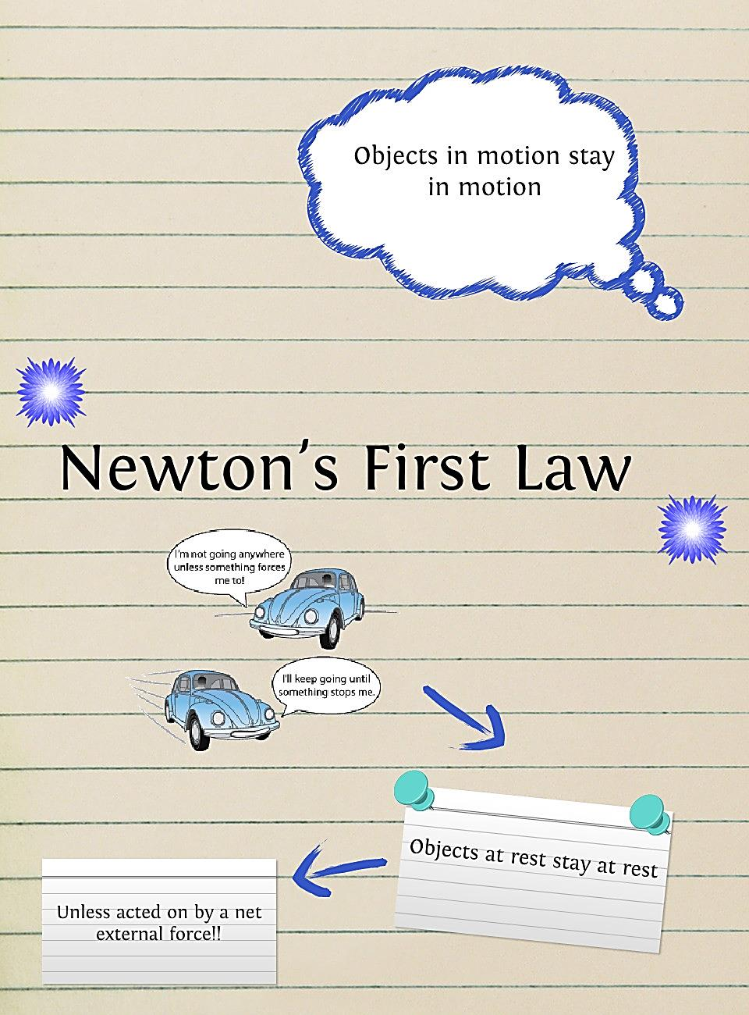

Slide 26
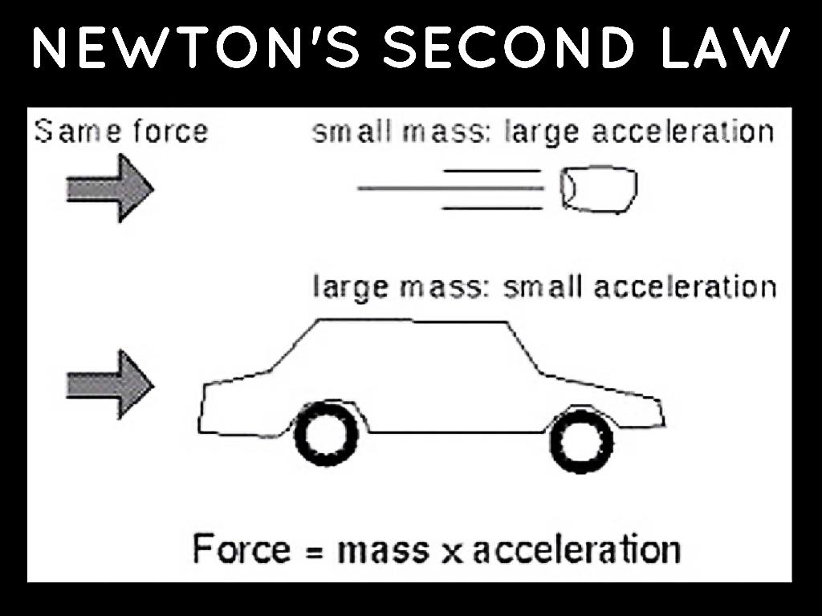

Slide 27
